Slide 1
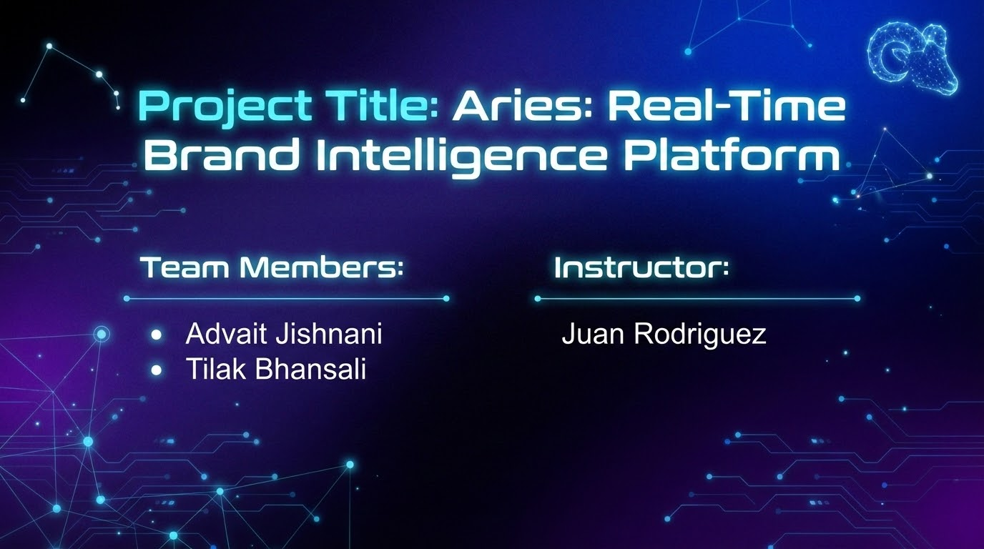
Notes:
"Good evening professor. We are Advait Jishnani and Tilak Bhansali, and this is our final project: 'Aries,' a Real-Time Brand Intelligence Platform. We designed this system to solve a critical issue in modern business: the gap between a crisis happening and the company knowing about it."

Slide 2
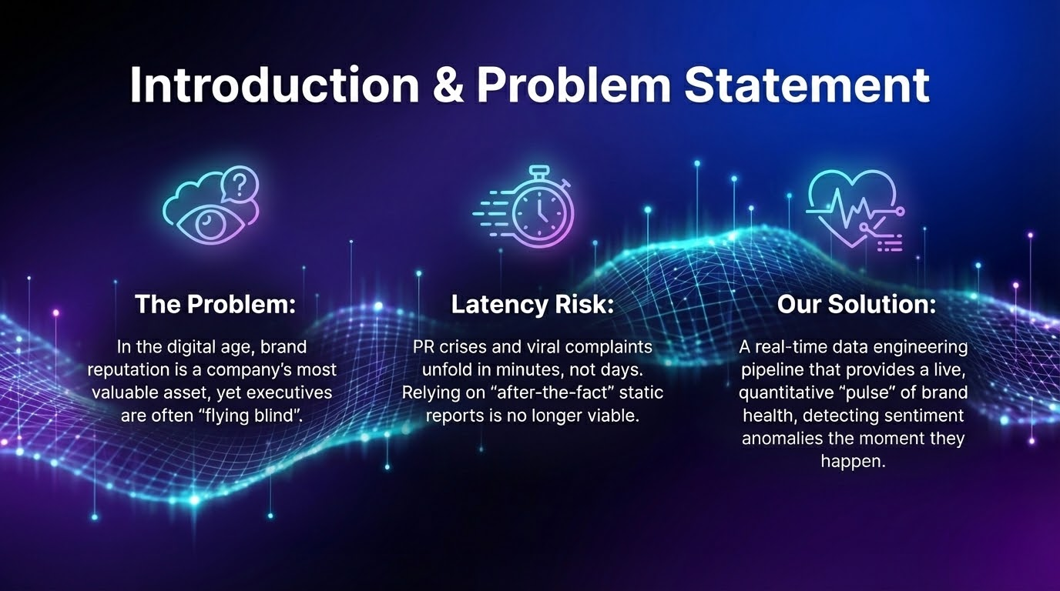
Notes:
"In today's digital landscape, brand reputation is an asset, but it's incredibly fragile. The problem we identified is that executives are currently 'flying blind.' Most companies rely on daily or weekly reports. But a PR crisis, a viral complaint, or a product failure happens in minutes, not days. By the time the traditional report arrives, the damage is already done. Our objective was to build a data engineering solution that closes this latency gap, giving companies a live, quantitative 'pulse' on their brand health."

Slide 3
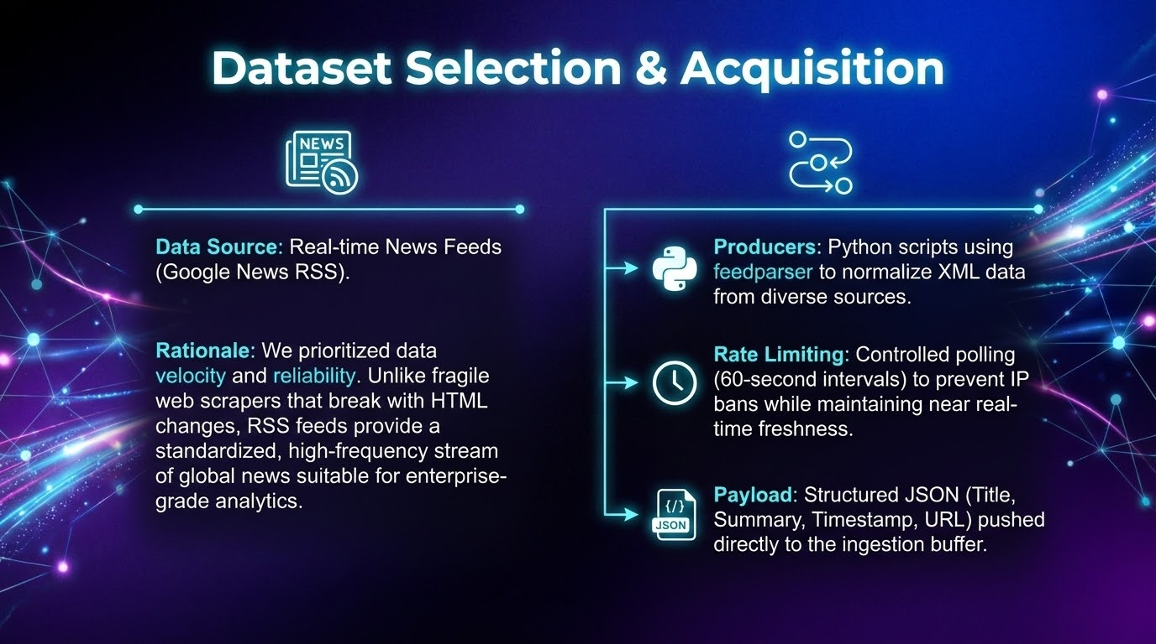
Notes:
"For our data source, we made a strategic decision to prioritize velocity and reliability. While we initially considered web scraping, we pivoted to Real-Time News RSS Feeds via Google News. Web scrapers are fragile—they break whenever a website changes its HTML. RSS feeds, however, provide a standardized, authorized stream of high-velocity data. We implemented Python producers using feedparser that poll global sources every 60 seconds. This setup mirrors a production 'firehose' environment, ensuring we get structured, reliable data without the risk of IP bans."

Slide 4
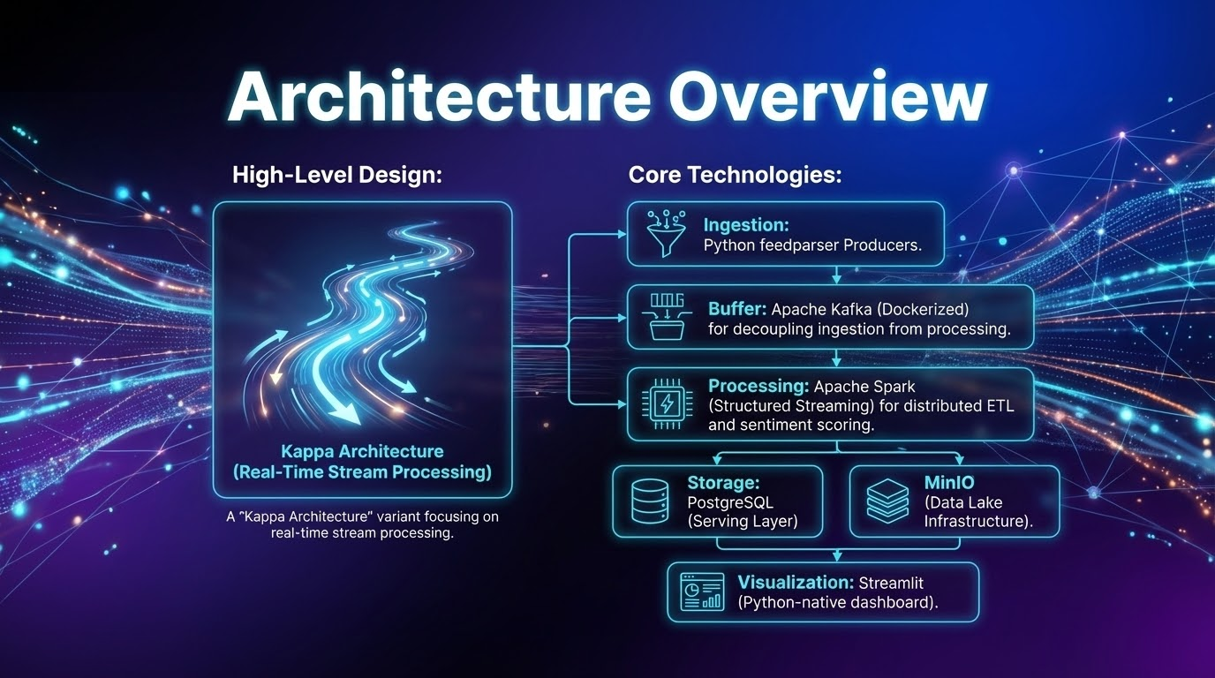
Notes:
"This is the core of our 'Big Data' design. We built a decoupled, containerized pipeline . Crucially, we do not write data directly from the source to the database. Instead, we use Apache Kafka as a buffer. This decouples our ingestion layer from our processing layer. If our processing slows down or crashes, the data simply queues up in Kafka rather than being lost. From there, Spark Structured Streaming picks up the data for processing, and we use a hybrid storage approach: MinIO as a Data Lake for raw archival, and PostgreSQL as a serving layer for the dashboard."

Slide 5
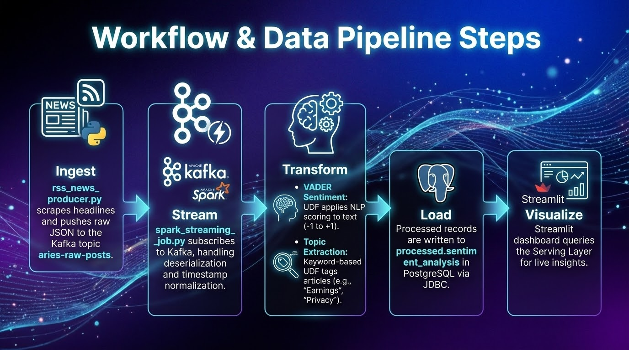
Notes:
"Let’s walk through the life of a single data point in our system:
Ingestion: Our Python producer captures a headline like 'Tesla recalls vehicles.' It serializes this into JSON and pushes it to the aries-raw-posts Kafka topic.
Streaming: Spark reads this JSON immediately. It handles deserialization and standardizes the timestamps.
Transformation: We apply two User Defined Functions (UDFs). First, VADER analyzes the sentiment. Second, a keyword extractor tags the article with topics like 'Safety' or 'Finance.'
Load: Finally, the enriched record is committed to our Postgres database, making it instantly queryable."

Slide 6
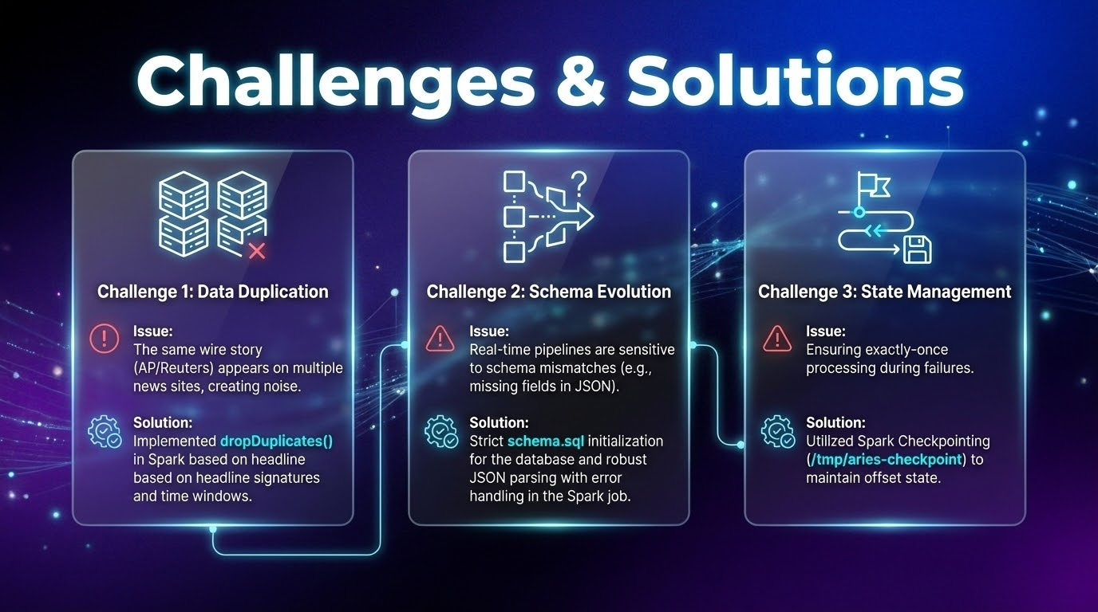
Notes:
"We encountered three main technical challenges:
First was Data Duplication. A single wire story from Reuters might appear on CNN, CNBC, and the NYT. This creates noise. We solved this by using Spark's dropDuplicates function with watermarking to filter out identical headlines within a specific time window.
Second was Schema Evolution. Real-time streams are messy. We enforced a strict schema validation at the database level to prevent corrupt data from breaking our analytics.
Third was State Management. To ensure we don't lose data during a crash, we utilized Spark Checkpointing to save the state of our stream to disk."

Slide 7
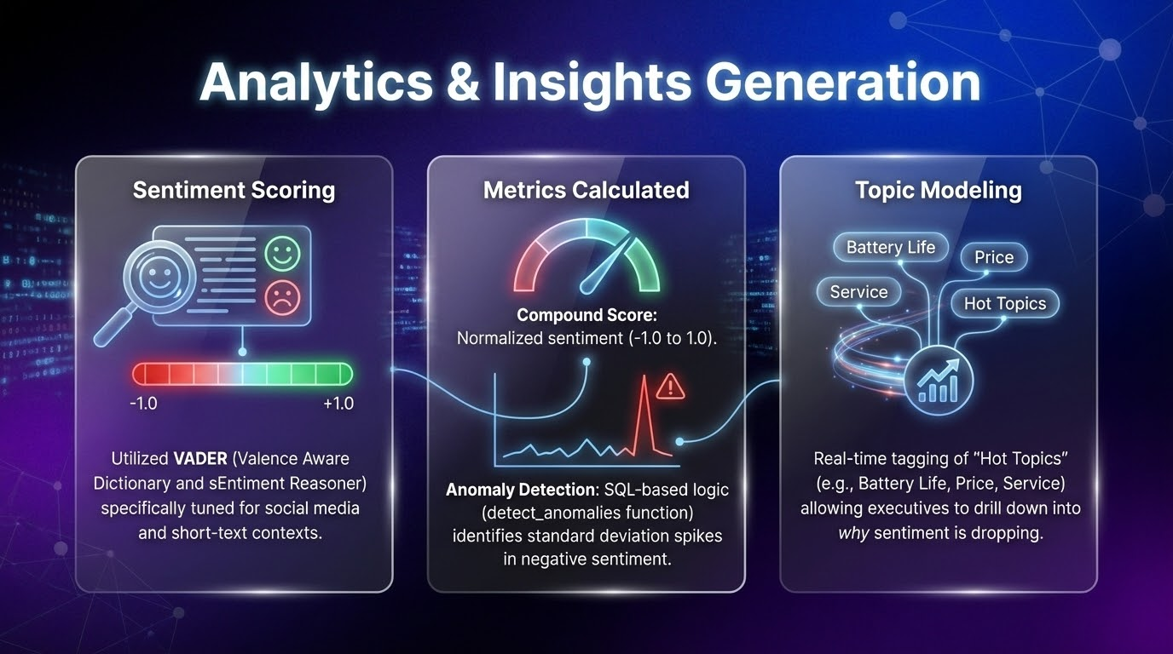
Notes:
"For analytics, we didn't just want raw counts. We focused on actionable insights. We use VADER for sentiment scoring because it is specifically tuned for short-form text. We also built an Anomaly Detection logic in SQL. This calculates the standard deviation of negative sentiment over the last hour. If the current sentiment spikes beyond 2 standard deviations, the system flags it as an 'Anomaly'—effectively a crisis alert."

Slide 8
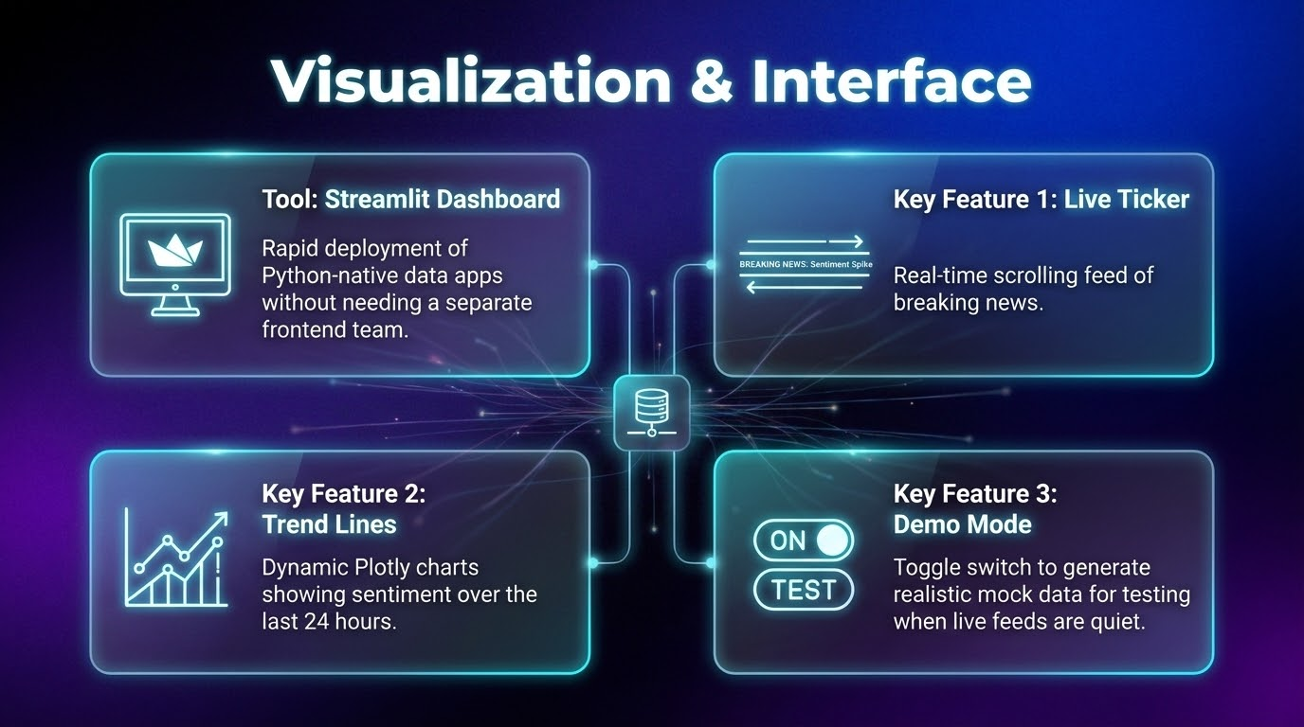
Notes:
"Finally, the interface. We built a Streamlit dashboard to visualize this data. It connects directly to our Postgres serving layer. You can see a live ticker of news as it arrives, and a time-series chart showing the sentiment trend over the last 24 hours. We also implemented a 'Demo Mode' switch, which allows us to demonstrate the visualization capabilities even if the live RSS feeds are momentarily quiet during a presentation."

Slide 9
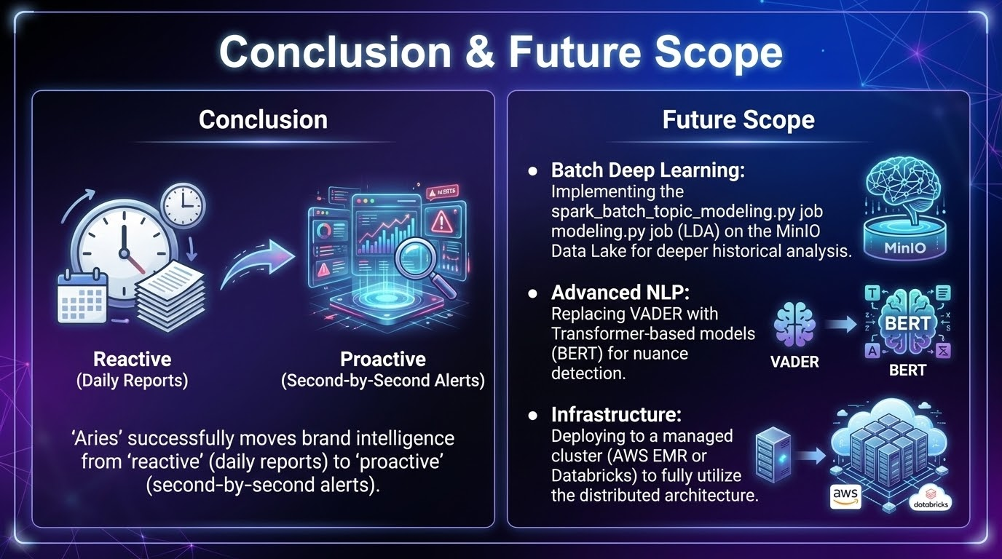
Notes:
"In conclusion, Aries successfully transforms a chaotic stream of global news into structured, actionable business intelligence. Looking ahead, our roadmap includes:
Batch Deep Learning: Implementing a nightly Spark job on our MinIO Data Lake to run LDA Topic Modeling for deeper historical trends.
Advanced NLP: Upgrading from VADER to BERT-based models for better nuance.
Cloud Deployment: Moving our Docker containers to a managed Kubernetes cluster for true production scale."

Slide 10
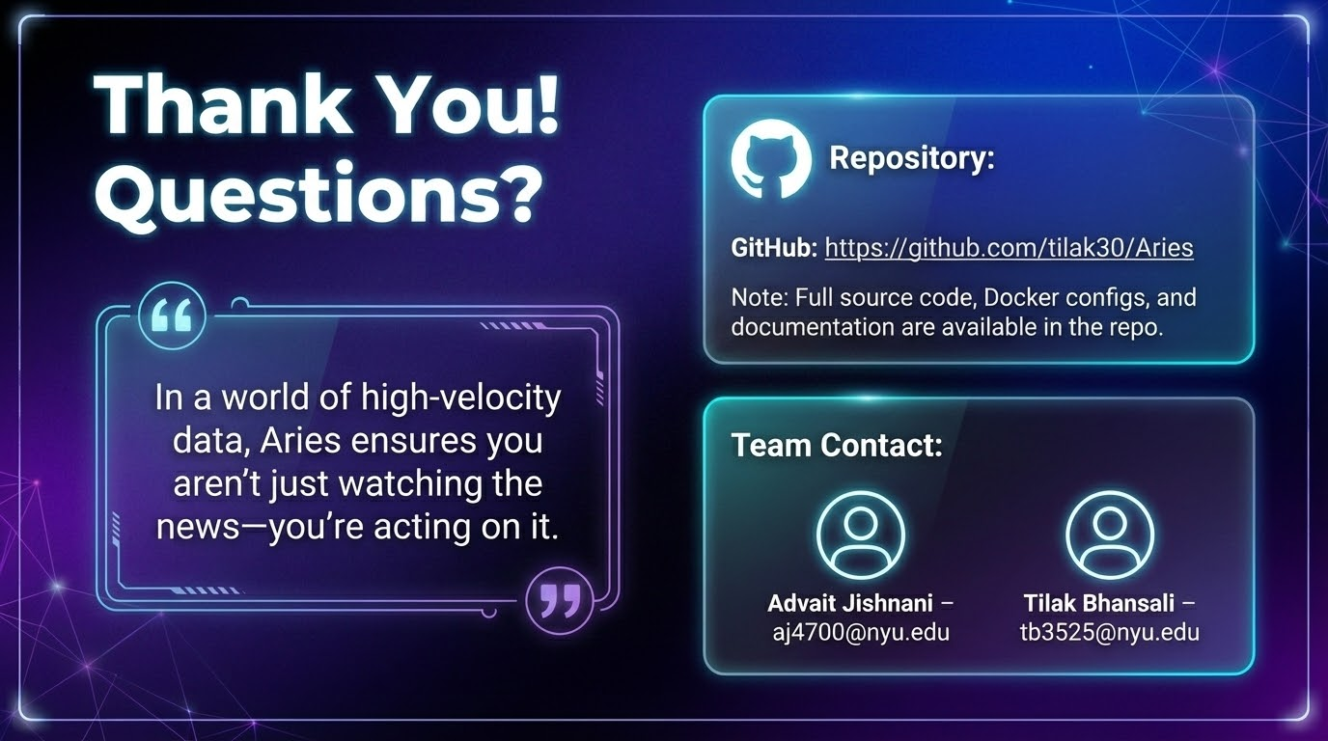
Notes:
"Thank you for your time. The full source code and infrastructure scripts are available on our GitHub. We are happy to take any questions about the architecture or the code."

Slide 11
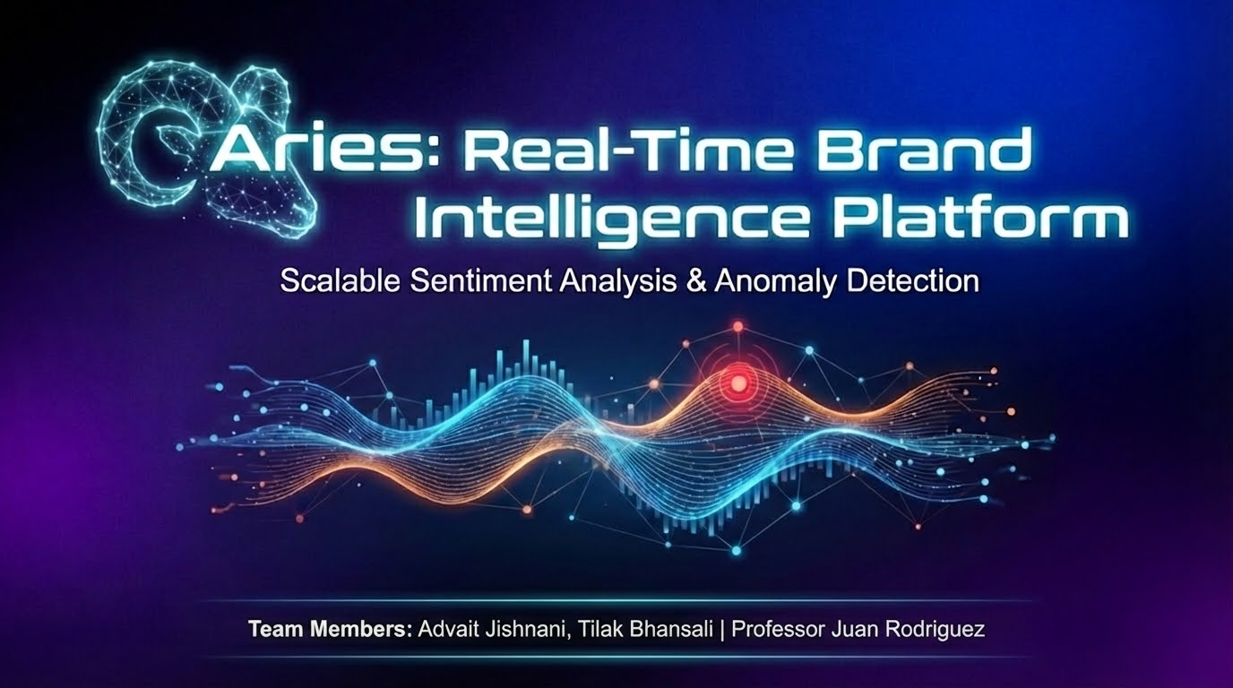

Slide 12
Project Title: Aries: Real-Time Brand Intelligence Platform
Team Members:
Advait Jishnani
Tilak Bhansali
Instructor: Juan Rodriguez

Slide 13
Introduction & Problem Statement
The Problem: In the digital age, brand reputation is a company's most valuable asset, yet executives are often "flying blind".
Latency Risk: PR crises and viral complaints unfold in minutes, not days. Relying on "after-the-fact" static reports is no longer viable.
Our Solution: A real-time data engineering pipeline that provides a live, quantitative "pulse" of brand health, detecting sentiment anomalies the moment they happen.

Slide 14
Dataset Selection & Acquisition
Data Source: Real-time News Feeds (Google News RSS).
Rationale: We prioritized data velocity and reliability. Unlike fragile web scrapers that break with HTML changes, RSS feeds provide a standardized, high-frequency stream of global news suitable for enterprise-grade analytics.
Ingestion Process:
Producers: Python scripts using feedparser to normalize XML data from diverse sources.
Rate Limiting: Controlled polling (60-second intervals) to prevent IP bans while maintaining near real-time freshness.
Payload: Structured JSON (Title, Summary, Timestamp, URL) pushed directly to the ingestion buffer.

Slide 15
Architecture Overview
High-Level Design: A "Kappa Architecture" variant focusing on real-time stream processing.
Core Technologies:
Ingestion: Python feedparser Producers.
Buffer: Apache Kafka (Dockerized) for decoupling ingestion from processing.
Processing: Apache Spark (Structured Streaming) for distributed ETL and sentiment scoring.
Storage: PostgreSQL (Serving Layer) and MinIO (Data Lake Infrastructure).
Visualization: Streamlit (Python-native dashboard).

Slide 16
Workflow & Data Pipeline Steps
Ingest: rss_news_producer.py scrapes headlines and pushes raw JSON to the Kafka topic aries-raw-posts.
Stream: spark_streaming_job.py subscribes to Kafka, handling deserialization and timestamp normalization.
Transform:
VADER Sentiment: UDF applies NLP scoring to text (-1 to +1).
Topic Extraction: Keyword-based UDF tags articles (e.g., "Earnings", "Privacy").
Load: Processed records are written to processed.sentiment_analysis in PostgreSQL via JDBC.
Visualize: Streamlit dashboard queries the Serving Layer for live insights.

Slide 17
Challenges & Solutions
Challenge 1: Data Duplication.
Issue: The same wire story (AP/Reuters) appears on multiple news sites, creating noise.
Solution: Implemented dropDuplicates() in Spark based on headline signatures and time windows.
Challenge 2: Schema Evolution.
Issue: Real-time pipelines are sensitive to schema mismatches (e.g., missing fields in JSON).
Solution: Strict schema.sql initialization for the database and robust JSON parsing with error handling in the Spark job.
Challenge 3: State Management.
Issue: Ensuring exactly-once processing during failures.
Solution: Utilized Spark Checkpointing (/tmp/aries-checkpoint) to maintain offset state.

Slide 18
Analytics & Insights Generation
Sentiment Scoring: Utilized VADER (Valence Aware Dictionary and sEntiment Reasoner) specifically tuned for social media and short-text contexts.
Metrics Calculated:
Compound Score: Normalized sentiment (-1.0 to 1.0).
Anomaly Detection: SQL-based logic (detect_anomalies function) identifies standard deviation spikes in negative sentiment.
Topic Modeling: Real-time tagging of "Hot Topics" (e.g., Battery Life, Price, Service) allowing executives to drill down into why sentiment is dropping.

Slide 19
Visualization & Interface
Tool: Streamlit Dashboard.
Key Features:
Live Ticker: Real-time scrolling feed of breaking news.
Trend Lines: Dynamic Plotly charts showing sentiment over the last 24 hours.
Demo Mode: toggle switch to generate realistic mock data for testing when live feeds are quiet.
Why Streamlit? Rapid deployment of Python-native data apps without needing a separate frontend team.

Slide 20
Conclusion & Future Scope
Conclusion: "Aries" successfully moves brand intelligence from "reactive" (daily reports) to "proactive" (second-by-second alerts).
Future Scope:
Batch Deep Learning: Implementing the spark_batch_topic_modeling.py job (LDA) on the MinIO Data Lake for deeper historical analysis.
Advanced NLP: Replacing VADER with Transformer-based models (BERT) for nuance detection.
Infrastructure: Deploying to a managed cluster (AWS EMR or Databricks) to fully utilize the distributed architecture.

Slide 21
Heading: Thank You!
Sub-heading: Questions?
Repository:
GitHub: https://github.com/tilak30/Aries
Note: Full source code, Docker configs, and documentation are available in the repo.
Team Contact:
Advait Jishnani – aj4700@nyu.edu
Tilak Bhansali – tb3525@nyu.edu
Closing Thought: "In a world of high-velocity data, Aries ensures you aren't just watching the news—you're acting on it."

Slide 22
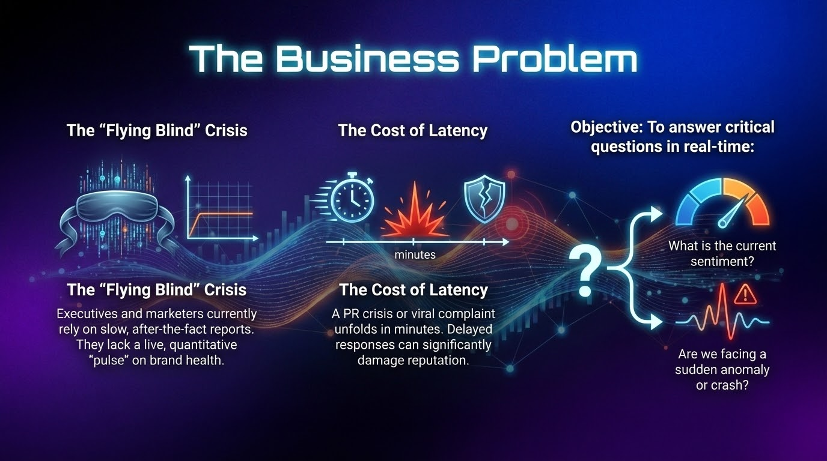

Slide 23
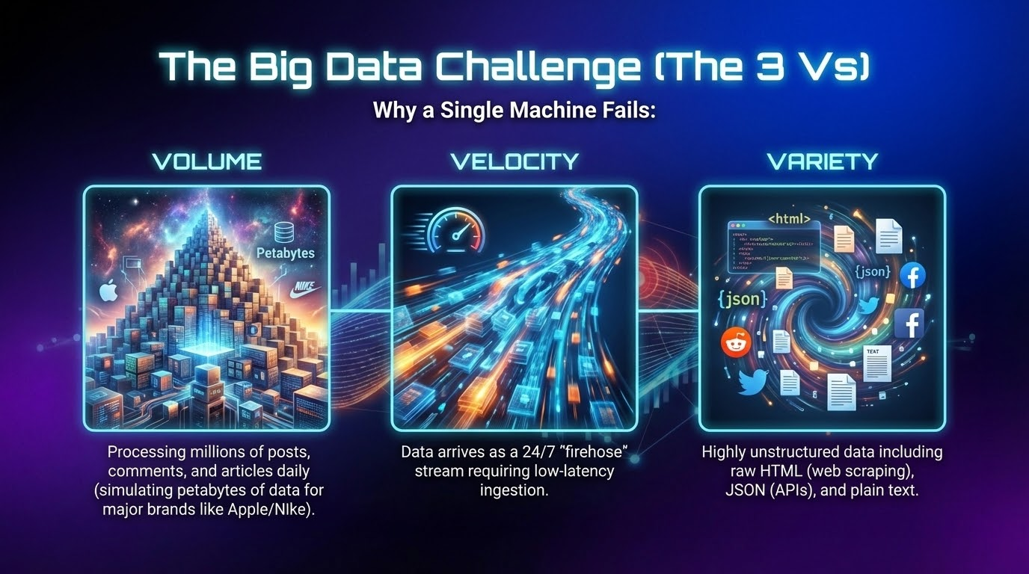

Slide 24
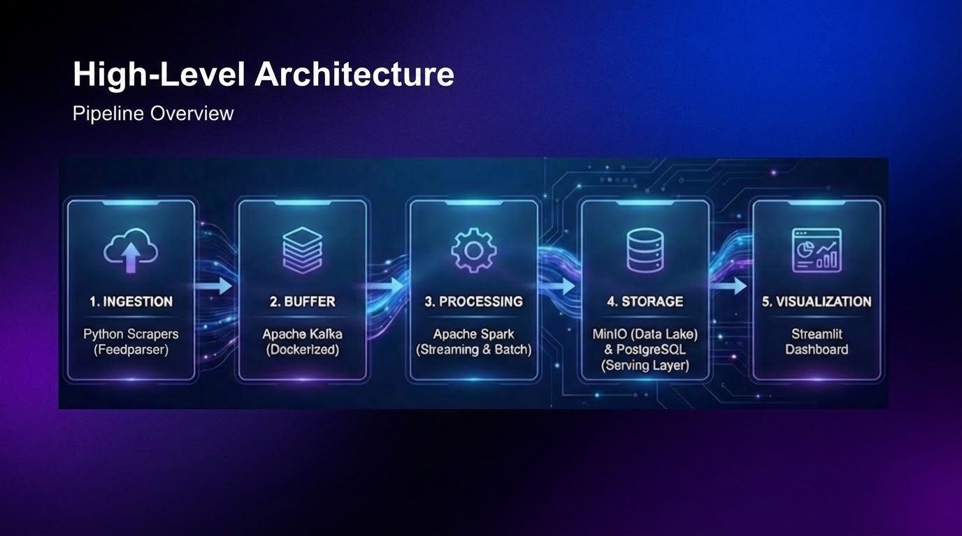

Slide 25
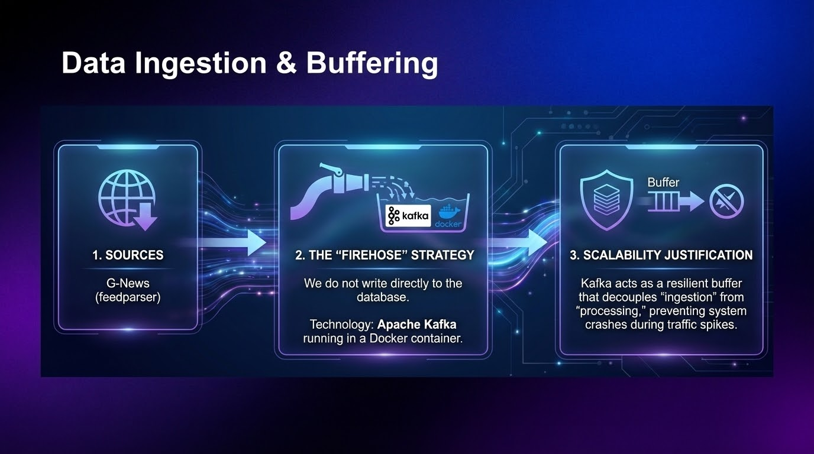

Slide 26
Distributed Processing (The Core)
Engine: Apache Spark (PySpark)
Dual-Path Processing:
Stream Job (Real-Time): Spark Structured Streaming reads from Kafka, applies VADER sentiment analysis, and aggregates into 1-minute windows.
Batch Job (Historical): Reads from the Data Lake (MinIO) for heavier NLP tasks like Topic Modeling (Spark MLlib).

Slide 27
Data Ingestion & Buffering
Sources: Reddit (via PRAW) and General Web (via Scrapy).
The "Firehose" Strategy: We do not write directly to the database.
Technology: Apache Kafka running in a Docker container.
Scalability Justification: Kafka acts as a resilient buffer that decouples "ingestion" from "processing," preventing system crashes during traffic spikes.

Slide 28
Data Ingestion & Buffering
Sources: Reddit (via PRAW) and General Web (via Scrapy).
The "Firehose" Strategy: We do not write directly to the database.
Technology: Apache Kafka running in a Docker container.
Scalability Justification: Kafka acts as a resilient buffer that decouples "ingestion" from "processing," preventing system crashes during traffic spikes.

Slide 29
Data Ingestion & Buffering
Sources: Reddit (via PRAW) and General Web (via Scrapy).
The "Firehose" Strategy: We do not write directly to the database.
Technology: Apache Kafka running in a Docker container.
Scalability Justification: Kafka acts as a resilient buffer that decouples "ingestion" from "processing," preventing system crashes during traffic spikes.

Slide 30
Data Ingestion & Buffering
Sources: Reddit (via PRAW) and General Web (via Scrapy).
The "Firehose" Strategy: We do not write directly to the database.
Technology: Apache Kafka running in a Docker container.
Scalability Justification: Kafka acts as a resilient buffer that decouples "ingestion" from "processing," preventing system crashes during traffic spikes.

Slide 31
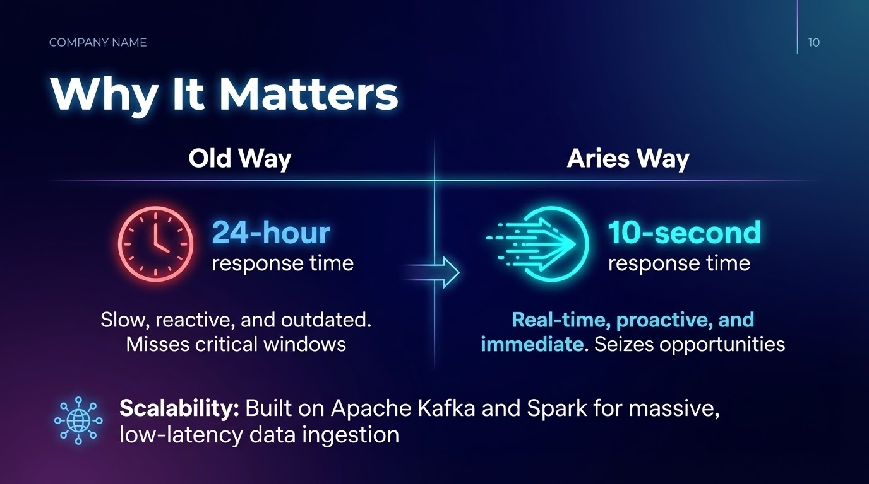
Notes:
"To wrap up, why does this matter?"
"We have reduced the 'Time-to-Insight' from 24 hours to 10 seconds."
"While this MVP uses Python and SQLite, the architecture is designed to scale. In a production environment, we would swap the backend for Apache Kafka and Spark Streaming to handle petabytes of data."
"Aries turns data into defense. Thank you, and the floor is open for questions."

